Slide 1
Notes:
bb

Slide 2

Swaminathan Vetri
Architect @ Maersk | Microsoft MVP

Slide 3
Architecting Large Scale DB migrations from On Prem to Azure
Swaminathan Vetri
October 20, 2022

Slide 4
About Me
Dad of 2 little princess ☺
Cloud Solution Architect at Maersk Technology Centre, Bengaluru
Microsoft MVP – Developer Technologies since 2016
Member of .NET Foundation
Twitter/GitHub - @svswaminathan
LinkedIn/YouTube – SwaminathanVetri
Blog – https://swaminathanvetri.in
Photography, Travelling, Blogging, Home automation

Slide 5
Agenda
Data Migration strategies
Data Migration Assessment
Data Migration tools & technologies
Choosing the right DB on Azure PaaS
Choosing the right networking options
Putting it all together
Tips, Gotchas from real world migration experiences
Learning Resources

Slide 6
Cloud Data Migration Strategies
As-Is
Minor DB modernization
Complete DB Modernization
One time data vs Continuous Change data capture
Online vs Offline
Azure Icons by icons8

Slide 7
Data Migration Phases
Migration
Post-Migration
Discover
Assess
Convert
Pre-Migration
Migrate
Sync Data
Cutover
Remediate applications
Perform tests
Optimize
Retire assets
Migrate SQL Server databases to Azure - Cloud Adoption Framework | Microsoft Learn
Notes:
Discovery: Inventory database assets and application stack.
Assess: Assess workloads and fix recommendations.
Convert: Convert source schema to work in the target.
Migrate: Migrate the source schema, source data and objects to target.
Sync data: Sync data (for minimal downtime).
Cutover: Cut over the source to target.
Remediate applications: Iteratively make and necessary changes to your applications.
Perform tests: Iteratively run functional and performance tests.
Optimize: Based on tests, address performance issues and then retest to confirm performance improvements.
Retire assets: Old VMs and hosting environments are backed up and retired.

Slide 8
Data Migration Assessment outcomes
Compatibility issues
Partially Supported or Unsupported features
Breaking changes
Behavior changes
Deprecated features
Performance
Security
Storage
Overview of Data Migration Assistant (SQL Server) - SQL Server | Microsoft Learn

Slide 9
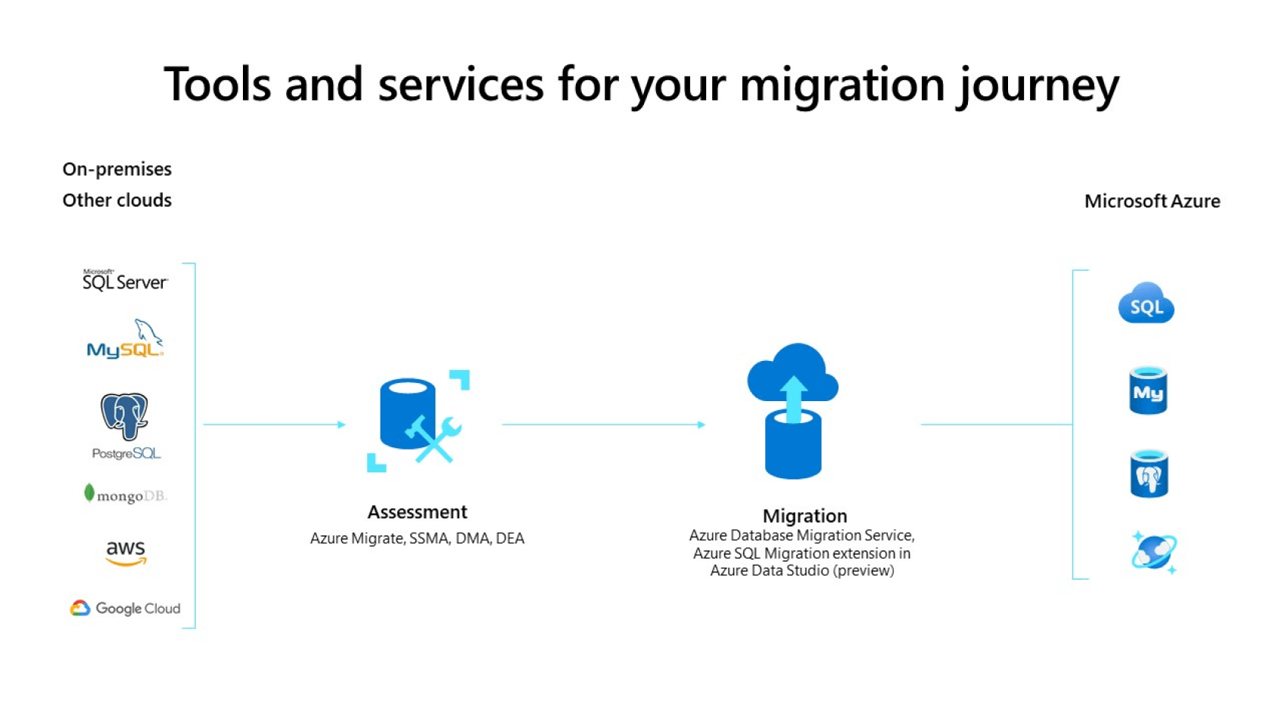
Data Migration Tools & Services
Pic courtesy: Azure Database Migration Service | Microsoft Azure

Slide 10
Data Migration Tools & Services
Assess
DMA
Migrate
SSMA
Azure SQL Migration extension for Azure Data Studio
DMS
SSMA
Azure SQL migration extension for Azure data Studio
Azure Data Factory
Azure DataBricks
Azure Migrate
DMA
Azure DataBox
3rd party/Partner tools
Azure Database Migration Service tools matrix | Microsoft Learn

Slide 11
Comparison of SQL migration tools
Capability | Azure Migrate | Data Migration Assistant (DMA) | SQL Server Migration Assistant (SSMA) | Azure Database Migration Service (DMS) | Database Experimentation Assistant (DEA)
Discover and assess SQL data estate | At scale | Yes | No | No | No
Migrate SQL Server objects to SQL Database or SQL Managed Instance | No | Yes | No | Yes | No
Lift and shift SQL Server to SQL Server on Azure VM | Yes | No | No | No | No
Migrate (and/or upgrade) SQL Server to SQL Server on Azure VM | No | Yes | No | No | No
Migrate non-SQL objects (Oracle, Access, DB2, and so on) | No | No | Yes | No | No
Migrate open source databases (MySQL, PostgreSQL, MariaDB, and so on) | No | No | No | Yes | No
Compare workloads between source and target SQL Server | No | No | No | No | Yes
Compare SQL data migration tools - SQL Server | Microsoft Learn

Slide 12
How these tools work?

Slide 13
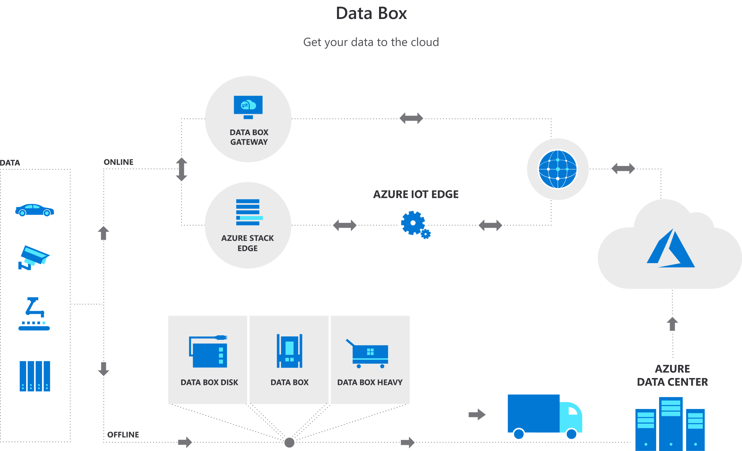
Migrate using Data Box
Pic Courtesy : Azure Data Box | Microsoft Azure

Slide 14
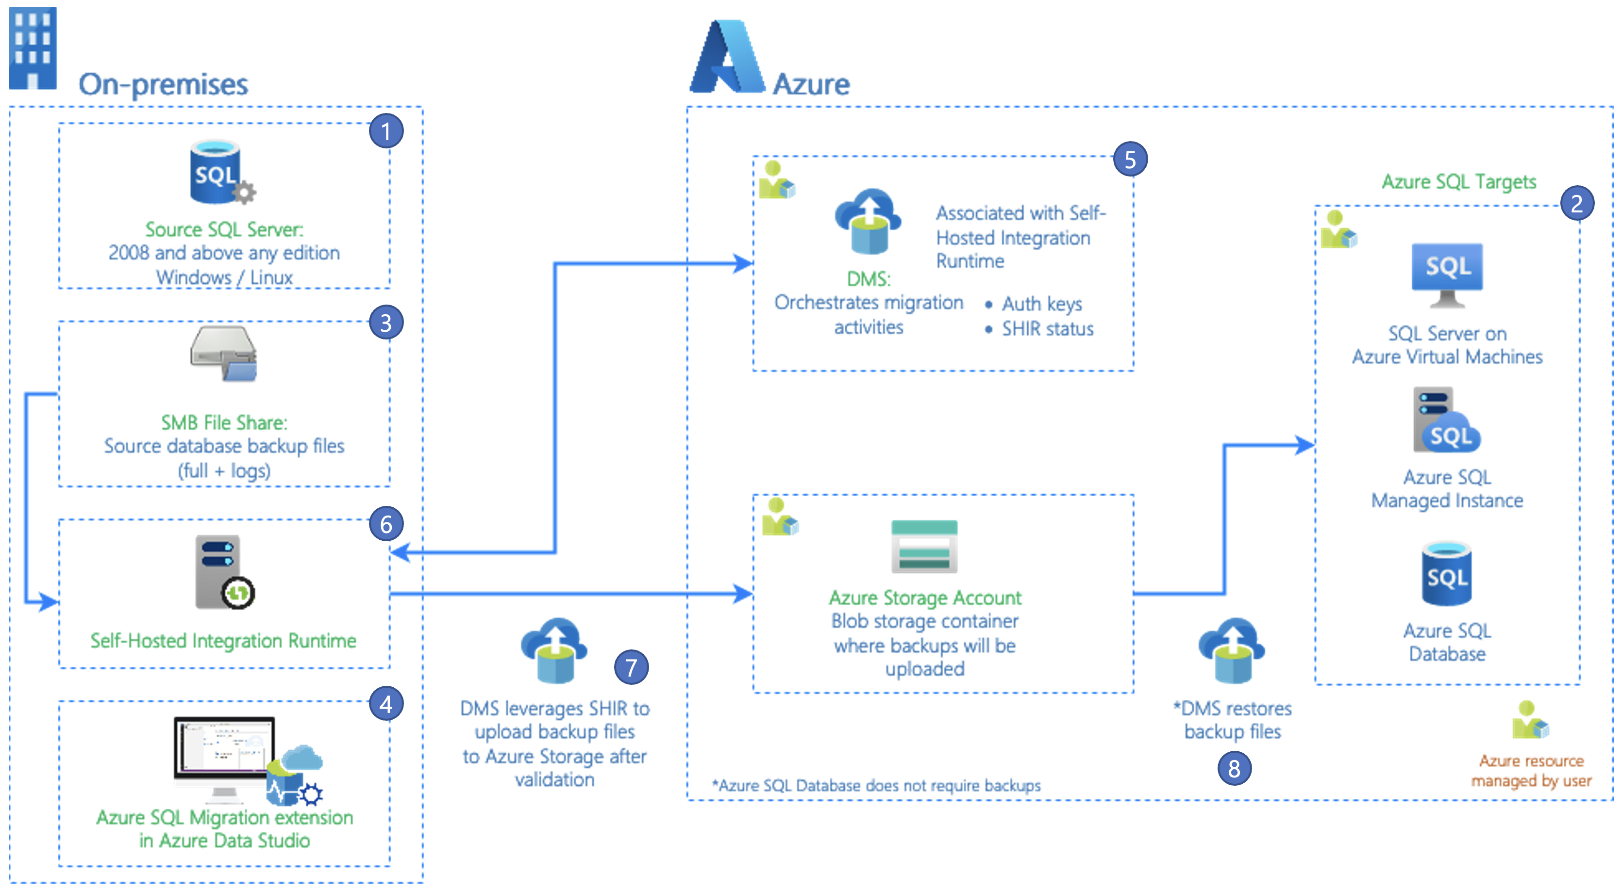
Migrate using Azure Data Studio
Pic courtesy: Migrate using Azure Data Studio | Microsoft Learn

Slide 15








Choice of DB on Azure
SQL Server on Azure VM
Azure SQL Managed Instance
Azure SQL Elastic Pool
Azure SQL Database
Azure Database PostgresQL
Azure Database MariaDB
Azure Database MySQL
Azure Cosmos DB

Slide 16
Criteria for Choosing DB
Functional requirements
Data Format
Data size
Scale and Structure
Data relationships
Consistency
Schema flexibility
Concurrency
Data movement
Data lifecycle
NFRs
Performance & Scalability
Reliability
Replication
Limits

Slide 17
Criteria for Choosing DB – contd.,
Managed service vs self managed
Region availability
Portability
Licensing
Overall costs (incl operational)
Cost effectiveness
Security
Auditing
Networking requirements
Source: Criteria for data store choice - Azure Application Architecture Guide | Microsoft Learn

Slide 18
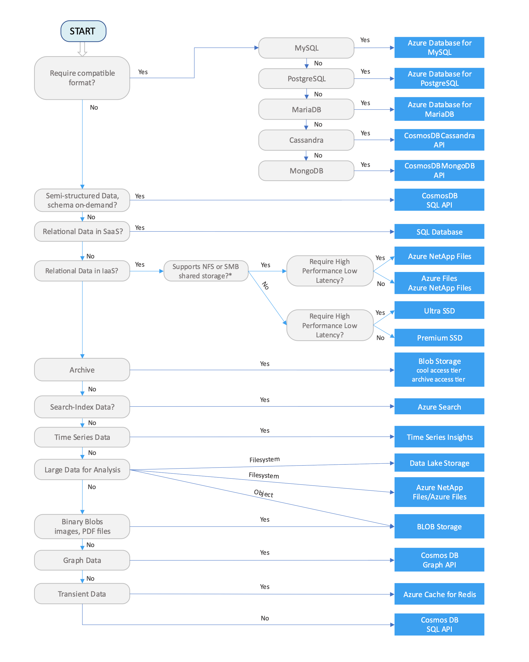
Choosing the right data store
Pic courtesy: Data store decision tree - Azure Application Architecture Guide | Microsoft Learn

Slide 19
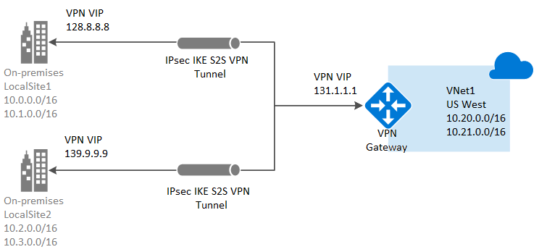
Choice of networking options
VPN Gateway
Benefits
Simple to configure.
Much higher bandwidth available; up to 10 Gbps depending on the VPN Gateway SKU.
Challenges
Requires an On Prem device
Availability guarantee only for VPN gateway device & not for network connections
Pic courtesy: Connect an on-premises network to Azure - Azure Architecture Center | Microsoft Learn

Slide 20
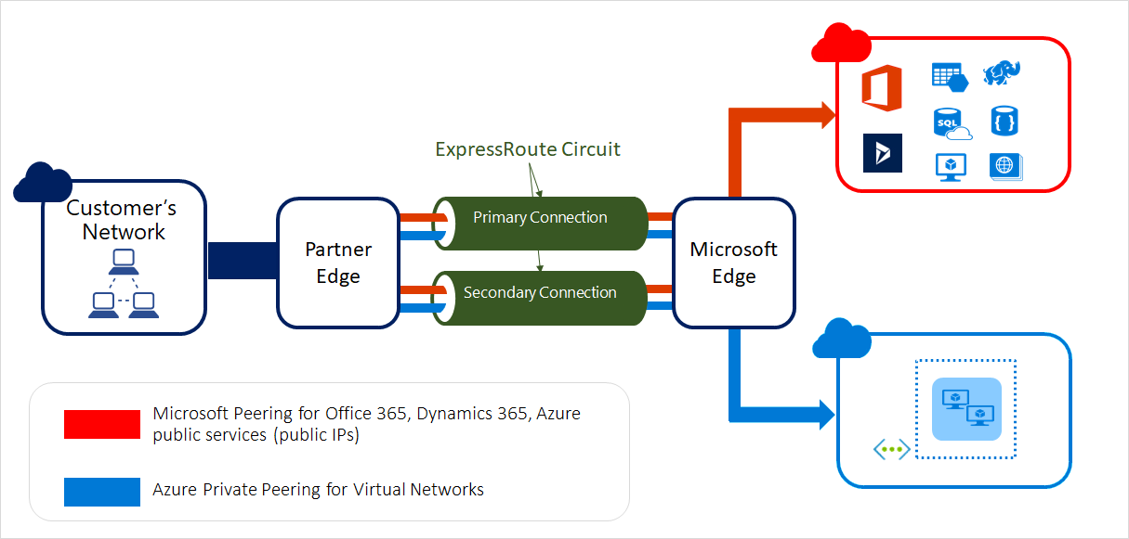
Choice of networking options
Express Route
Benefits
Much higher bandwidth available; up to 10 Gbps depending on the connectivity provider.
Lower and more consistent latencies compared to typical connections over the Internet.
Supports dynamic scaling of bandwidth to help reduce costs during periods of lower demand. However, not all connectivity providers have this option.
May allow your organization direct access to national clouds, depending on the connectivity provider.
99.9% availability SLA across the entire connection.
Challenges
Can be complex to set up. Creating an ExpressRoute connection requires working with a third-party connectivity provider. The provider is responsible for provisioning the network connection.
Requires high-bandwidth routers on-premises.
Pic courtesy: Connect an on-premises network to Azure - Azure Architecture Center | Microsoft Learn

Slide 21
Putting it all together
What worked for our migration scenario

Slide 22
Oracle to Cloud DB Migration
Migration goals:
Perform one time data load from Oracle DB to Cloud DB
Enable CDC (change data capture) from Oracle to Cloud DB
Data movement to be done with minimal schema changes
Create new microservices to read data from Cloud DB
Writes to happen in the Oracle DB and synched to Cloud DB via CDC with <10s latency SLA
Replicate approx. 30M transactions in a day
Cloud DB to be setup with HA (High availability)/DR (Disaster Recovery)
Cloud DB to be setup with defined RTO and RPO

Slide 23
How do we address these goals?
Which DB to choose on Azure?
Which networking option to choose?
How do we achieve HA?
How do we achieve BC/DR?
How do we enable new Microservices development on Cloud?
How do we bring down the read/write latencies?

Slide 24
Our choice
Business Critical Tier for low read/write latency workloads
Read scale out enabled
General purpose tier for normal workloads
Fail Over groups enabled for BC/DR
PITR/LTR backups
Firewall rules to prevent unauthorized access
Private endpoint-based connectivity
Azure SQL Database (PaaS)

Slide 25
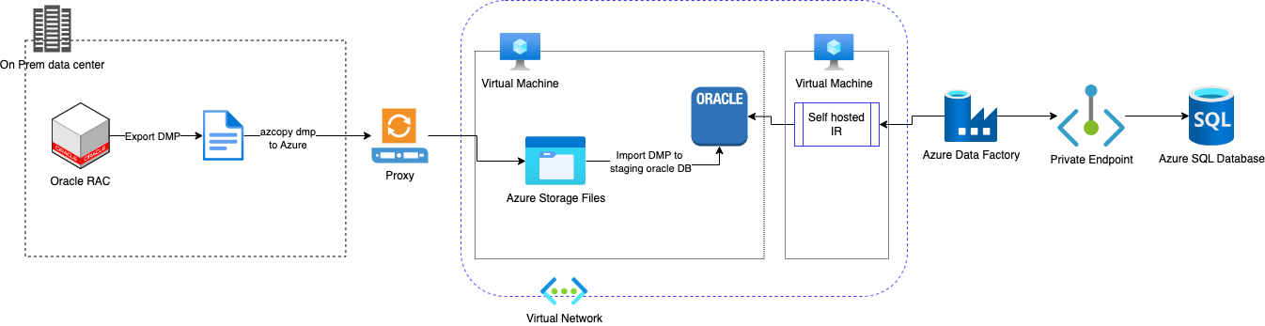
Migration Architecture
One time load architecture

Slide 26
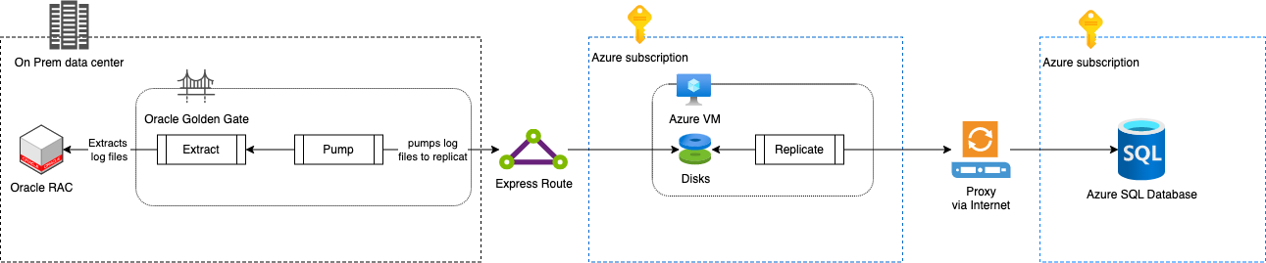
Migration architecture – contd.,
CDC with Oracle Golden Gate

Slide 27
Our Challenges/Learnings
Choice of right tier in Azure SQL DB to meet SLAs
Offline over online migration
Networking setup
Metadata migration
Duration of migration
Making the entire migration process repeatable
Post migration verification & consistency check
Enabling CDC and tuning it to meet SLAs
Indexes
Constraints
Monitoring & Alerting for CDC failures/lags

Slide 28
Resources
Azure Database Migration Service tools matrix | Microsoft Learn
Azure Database Migration Guides | Microsoft Learn
Migration architecture design - Azure Architecture Center | Microsoft Learn

Slide 29
Q & A

Slide 30



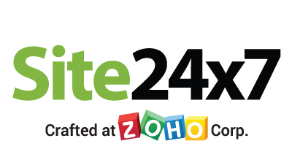


Platinum Partner
Gold Partner
Silver Partner

Slide 31
THANK YOU!!!
Architecting Large Scale DB Migrations from On Prem to Azure
Swaminathan Vetri
Architect, Maersk | Microsoft MVP

